Slide 1
CS601PC:MACHINE LEARNING
III CSE E
ASHA
KMIT

Slide 2
COURSE OBJECTIVES
This Course Explains Machine Learning Techniques Such As Decision Tree Learning bayesian Learning Etc.
To Understand Computational Learning Theory
To Study The Pattern Comparsion Techniques.

Slide 3
COURSE OUTCOMES
This Course Explains Machine Learning Concepts Of Computational Intelligence Like Machine Learning.
Ability To Get The Skill To Apply Machine Learning Techniques To Address The Real Time Problems In Different Areas.
Understand The Neual Networks And Its Usage In Machine Learning Application.

Slide 4
Textbook
Tom M. Mitchell
Machine Learning
McGraw-Hill, New York

Slide 5
CHAPTER 1
INTRODUCTION
CONTENTS:
WELL-POSED LEARNING PROBLEMS
DESIGNING A LEARNING SYSTEM
PERSPECTIVES AND ISSUES IN MACHINE LEARNING

Slide 6
Definition of Learning
A computer program is said to learn from experience E
with respect to some class of tasks T
and performance measure P,
if its performance at tasks in T,
as measured by P,
improves with experience E.

Slide 7
Definition Continued
Choice of P very important!! - Expert system or human comprehension? - Datamining!!
Broad enough to include most tasks that we would call “learning tasks” but also programs that improve from experience in quite straightforward ways (rote learning or caching)!
A database system that allows users to update data entries - it improves its performance at answering database queries, based on the experience gained from databases updates (same issue as what is intelligence)

Slide 8
Learning to Play Checkers
T : Play checkers
P : Percent of games won in world tournament
What experience?
What exactly should be learned?
How shall it be represented?
What speci c algorithm to learn it?

Slide 9
Example Learning Problems
Handwriting Recognition:
T: recognising and classifying handwritten words with images
P: percent of words correctly classified
E: a database of handwritten words with given classifications
Robot driving:
T: driving on public four lane highways using vision sensors
P: average distance traveled before an error (as judged by human overseer)
E: a sequence of images and steering commands recorded while observing a human driver

Slide 10
Designing a Learning System
T: checkers (draughts)
P: percent of games won in world tournament
What experience?
What exactly should be learned?
How shall it be represented?
What specific algorithm to learn it?

Slide 11
Type of Training Experience
Direct or indirect?
Teacher or not?
A problem: is training experience representative of performance goal?

Slide 12
Direct versus Indirect Learning
Individual checkers board states and correct move for each
Move sequences and final outcomes of various games played
Credit assignment problem - the degree to which each move in the sequence deserves credit or blame for the final outcome - game can be lost even when early moves are optimal, if these are followed later by poor moves or vice versa

Slide 13
Teacher or not?
Degree to which learner controls the sequence of training examples
Teacher selects informative board states & provides the correct moves
For each proposed board state the learner finds particularly confusing it asks the teacher for correct move
Learner may have complete control as it does when it learns by playing itself with no teacher - learner may choose between experimenting with novel board states or honing its skill by playing minor variations of promising lines of play

Slide 14
Choose Training Experience
How well training experience represents the distribution of examples over which the final system performance P must be measured
P is percent of games in the world tournament, obvious danger when E consists of only games played against itself (probably can’t get world champion to teach computer!)
Most current theories of machine learning assume that the distribution of training examples is identical to the distribution of test examples
It is IMPORTANT to keep in mind that this assumption must often by violated in practice.
E: play games against itself (advantage of getting a lot of data this way)

Slide 15
Choose a Target Function
ChooseMove: B -> M where B is any legal board state and M is a legal move (hopefully the “best” legal move)
Alternatively, function V: B -> ℜ which maps from B to some real value where higher scores are assigned to better board states
Now use the legal moves to generate every subsequent board state and use V to choose the best one and therefore the best legal move

Slide 16
Choose a Target Function II
V(b) = 100, if b is a final board state that is won
V(b) = -100, if b is a final board state that is lost
V(b) = 0, if b is a final board state that is a draw
V(b) = V(b´), if b is not a final state where b´ is the best final board state starting from b assuming both players play optimally
Not computable!! - non-operational definition (changes over time!!! - Deep Blue)
Need Operational V - What are Realistic Time Bounds??
May be difficult to learn an operational form of V perfectly - Function Approximation V^{hat}

Slide 17
Choose Representation for Target Function
Use a large table with an entry specifying a value for each distinct board state
Collection of rules that match against features of the board state
Quadratic polynomial function of predefined board features
Artificial neural network
NOTICE - choice of representation is closely tied to algorithm choice!!

Slide 18
Expressability Tradeoff
Very expressive representations allow close approximations to the ideal target function V, but the more expressive the representation the more training data the program will require in order to choose among the alternative hypothesis
Also depending on the purpose, a more expressive representation might make it more or less easy for people to understand!

Slide 19
Design So Far
T: Checkers
P: percent of games won in world tournament
E: games played against self
V: Board -> ℜ
Target Function Representation:
V´(b) = w₀ + w₁x₁ + w₂x₂ + w₃x₃ + w₄x₄ + w₅x₅ + w₆x₆

Slide 20
Choose Function Approximation Algorithm
First need Set of training examples
<b,V_{train}(b)>
<(x₁=3,x₂=0,x₃=1,x₄=0,x₅=0,x₆=0),+100> because x₂=0
V_{train}(b) <- V´(successor(b))
Good if V´ tends to be more accurate for board positions closer to game’s end

Slide 21
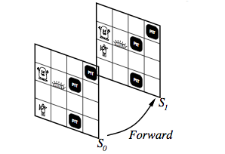
Successor

Slide 22
Choose Learning Algorithm
Learning Algorithm for choosing weights w_{i} to best fit the set of training examples
{<b,V_{train}(b)>} ≡ {<b,V´(Successor(b))>}
Best fit could be defined as minimizes the squared error E

Slide 23
Choose learning Algorithm II
We seek the weights that minimise E for the observed training examples
We need an algorithm that incrementally refines the weights as new training examples become available & is robust to errors in estimated training values
One such algorithm is LMS (basis of Neural Network algorithms)

Slide 24
Least Mean Squares
LMS adjusts the weights a small amount in the direction that reduces the error on this training example
Stochastic gradient-descent search through the space of possible hypothesis to minimize the squared error
Why stochastic ???

Slide 25
LMS Algorithm
LMS: For each <b,V_{train}(b)> use current weights to calculate V´(b). For each weight
Where η is a small constant .01 that moderates the size of the weight update

Slide 26
LMS Intuition
To get an intuitive understanding notice that
when the error is 0 no weights are changed,
when it is positive then each weight is increased in proportion to the value of its corresponding feature
Surprisingly, in certain settings this simple method can be proven to converge to the least squared approximation to V_{train}.
In how many training instances?
How understandable is the result? (Datamining)

Slide 27
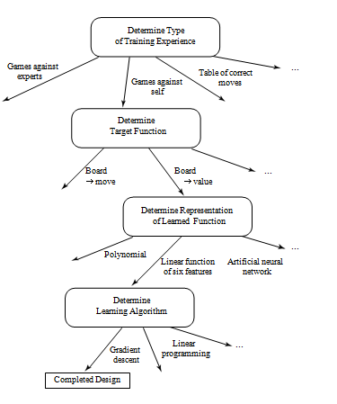
Design Choices

Slide 28
Some Issues in Machine Learning
What algorithms can approximate functions well (and when)?
How does number of training examples in uence accuracy?
How does complexity of hypothesis representation impact it?
How does noisy data in uence accuracy?
What are the theoretical limits of learnability?
How can prior knowledge of learner help?
What clues can we get from biological learning systems?
How can systems alter their own representations?

